Slide 1
PROJECT REPORT

Slide 2
Project
It is a work plan devised to achieve a specific objective with specified period of time.
A project has a single set of objectives, and when these objectives are reached the project is completed.
A sequence of tasks that must be completed to attain a certain outcome.
The three basic attributes are:-
Course of action
Specific objectives
Definite time perspective

Slide 3
Project objectives
Project objectives are concerned with defining in a precise manner what the project is expected to achieve and to provide a measure of performance for the project as a whole.
Requirements for project objectives are:-
Specific, not general
Not complex
Measurable, tangible and verifiable
Consistent with organizational plans, policies and procedures.

Slide 4
Project report
Soon after the identification of a project and its implementation, the project report is formulated.
Project report assessed the demand of the proposed product to be produced, works out the cost of investment as well as the operational cost and thus estimates the expected profitability of the proposed investment.

Slide 5
A project report incorporating relevant data of a project serves as a guide to management and records merits and demerits in allocating resources to production of specific goods and services.
In other words, Project Report or Business Plan is a Written Document of what an Entrepreneur proposes to take up & his course of action to establish his Enterprise.
The Project Report serves like a Road Map to reach the Destination determined by the Entrepreneur. Thus, a Project Report can best be defined as a well evolved course of action devised to achieve the Specified Objectives within a specified period of time
Project report is prepared by an expert after detailed study and analysis of various aspects of a project

Slide 6
Parties interested in project report are financial corporations, banks for getting loans, investors etc.
Scope of a project report:-
The project report should able to present justifications for investment on the basis of,
Economic aspects- present analysis of the market for the product to be manufactured.
Technical aspects
Financial aspects
Production aspects- description of the product selected for manufacturer and reasons for such selection.
Managerial aspects

Slide 7
Content of project report
Objectives and scope of report
Products characteristics
Market position and trends
Raw material
Manufacture
Plant and machinery
Land and building
Financial implication
Marketing channel
Personnel

Slide 8
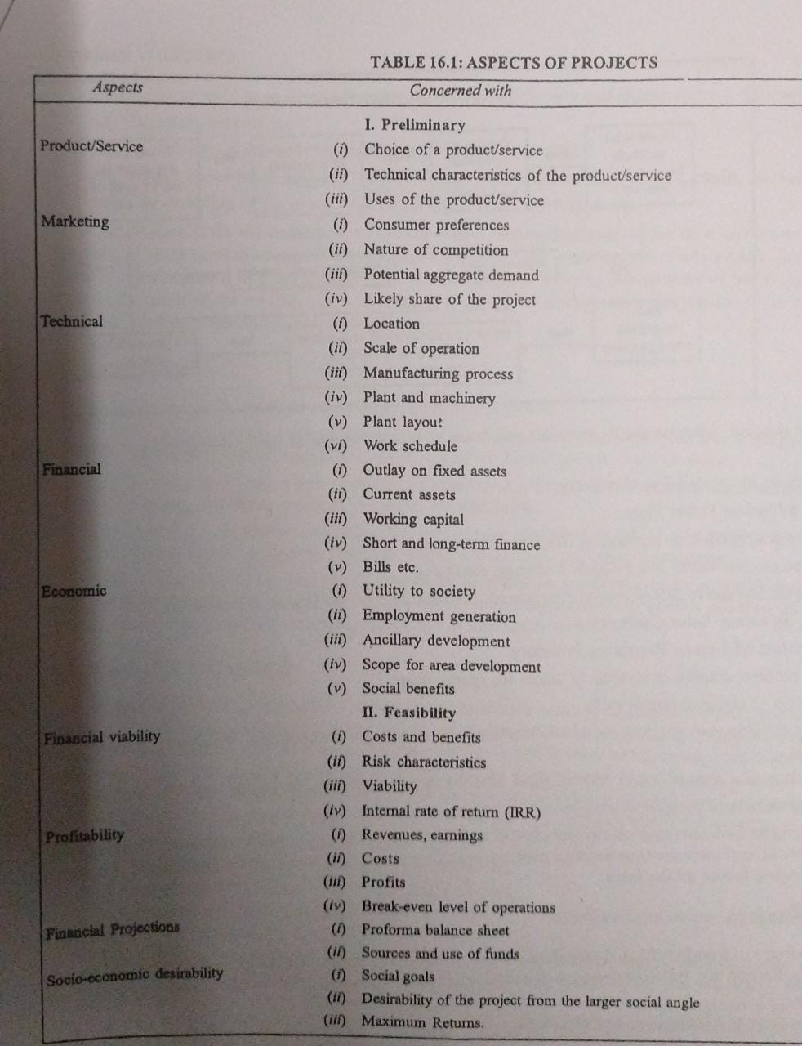

Slide 9
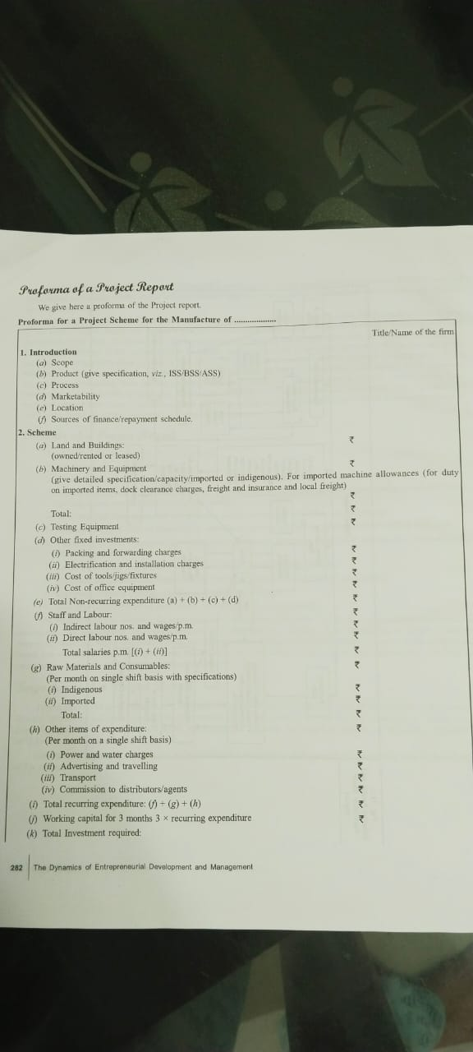

Slide 10
